Slide 1
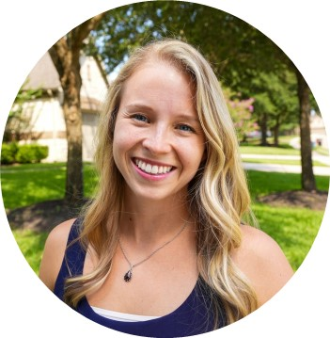
Laura Roberts Manager — Acceleration
Email
laura.roberts@thebridge.com
Location
Houston, Texas
Mobile
(281) 731-1369
Laura joined The Bridge in November 2017 and has over ten years of experience leading change management initiatives across various industries. She also has experience in learning & development as well as company-wide communication protocols.
EXPERIENCE
Industry Experience
Supply Chain & Distribution | Retail
Change Management Lead | Supply Chain & Distribution
Developed and executed Change Management playbook for a WMS rollout across 50+ warehouses for a $27 billion distribution company
Developed Case for Change materials for each role within the warehouses
Provided direct coaching and support to warehouse leadership regarding Change Management practices and leadership behaviors
Change Management Lead | Retail
Developed and ran company-wide Information Security Awareness campaign, reaching over 45K employees
8% fewer employees falling for a controlled phishing attack
21% more employees reported controlled phishing attack to help desk
Managed organizational impacts of an intraday sales report replatforming for 10K store employees
90% of users reported awareness of change
Minimal issues and questions reported to help desk
Change Management Lead | Supply Chain & Distribution
Developed and executed Change Management playbook for a B2B Digital Transformation for a $2 billion distribution company
Launched training and communications strategies for new B2B website to 10,000+ customers nationwide
Engaged and aligned key internal stakeholders to increase awareness of change and drive adoption Provided direct coaching and support to managers and supervisors regarding change management practices and leadership behaviors
BACKGROUND
Functional Skills
Change Management (Prosci certified), Learning & Development, Communications, Process Improvement, Performance Management, Project Management
Qualifications
Prosci Certified Change Practitioner

Slide 2
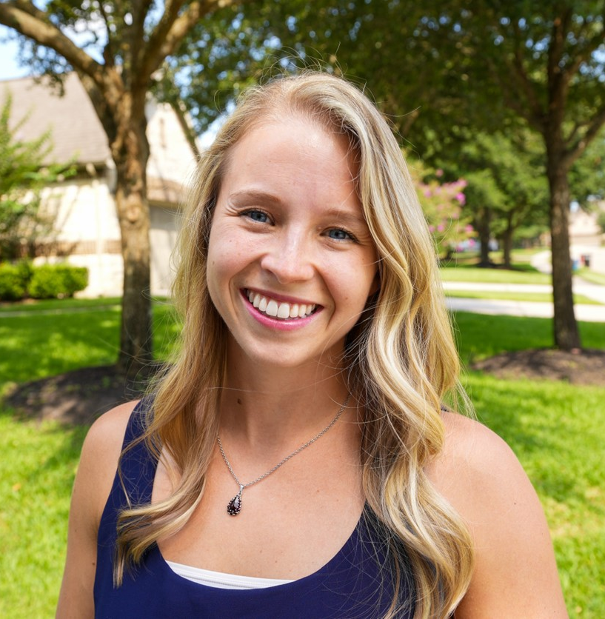

Email
laura.roberts@thebridge.com
Location
Houston, Texas
Mobile
(281) 731-1369
Laura joined The Bridge in November 2017 and has over ten years of experience leading change management initiatives across various industries. She also has experience in learning & development as well as company-wide communication protocols.
Laura Roberts Manager
Acceleration

Slide 3
Laura Roberts Manager - Acceleration
Email
laura.roberts@thebridge.com
Mobile
(281) 731-1369
Location
Houston, Texas
BACKGROUND
EXPERIENCE
Functional Skills
Change Management (Prosci certified), Learning & Development, Communications, Process Improvement, Performance Management, Project Management
Qualifications
Prosci Certified Change Practitioner
Industry Experience
Supply Chain & Distribution | Retail
Change Management Lead | Supply Chain & Distribution
Developed and executed Change Management playbook for a WMS rollout across 50+ warehouses for a $27 billion distribution company
Developed Case for Change materials for each role within the warehouses
Provided direct coaching and support to warehouse leadership regarding Change Management practices and leadership behaviors
Change Management Lead | Retail
Developed and ran company-wide Information Security Awareness campaign, reaching over 45K employees
8% fewer employees falling for a controlled phishing attack
21% more employees reported controlled phishing attack to help desk
Managed organizational impacts of an intraday sales report replatforming for 10K store employees
90% of users reported awareness of change
Minimal issues and questions reported to help desk
Change Management Lead | Supply Chain & Distribution
Developed and executed Change Management playbook for a B2B Digital Transformation for a $2 billion distribution company
Launched training and communications strategies for new B2B website to 10,000+ customers nationwide
Engaged and aligned key internal stakeholders to increase awareness of change and drive adoption Provided direct coaching and support to managers and supervisors regarding change management practices and leadership behaviors

